Slide 1
Shor’s Algorithm for Prime Factorization
Adham Elmadawy, Ayman Elfayoumi, Aimen Al-Doais

Slide 2
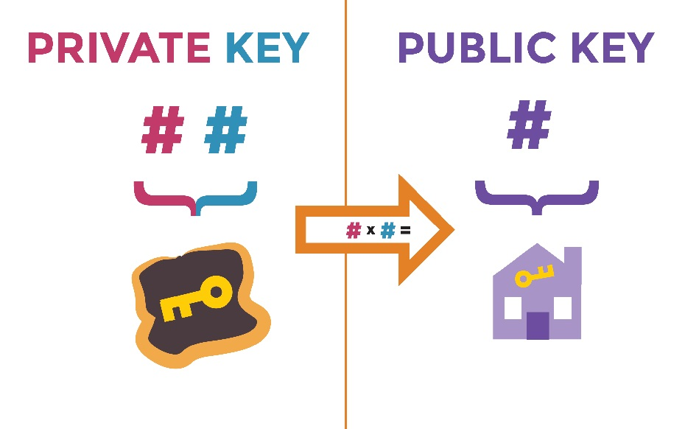
Rivest, Shamir, Adleman (RSA) Encryption
RSA is an asymmetric encryption algorithm
Sender encrypts with public key; Receiver decrypts with private key
Public key: Very large number (2048 bits)
Private key: Composed of the only 2 prime factors of public key

Slide 3
Importance of RSA
Used in many modern applications to encrypt sensitive data
Bank information, Social Security #, secure online communication
Relies on the fact that finding the prime factors (private key) is very hard
Finding an efficient algorithm to find the factors would break RSA encryption

Slide 4

The Prime Factorization Problem
Breaking RSA encryption requires an efficient algorithm to find prime factors (p & q) of a number (N)
N = p * q, Where p & q are prime numbers and factors of N
Only way to find p & q is to guess, giving exponential O($2^{N}$) efficiency
${\frac{1}{2}(2}^{N}$) guesses on average
Some algorithms skip some redundant guesses, but the fastest classical algorithm is GNFS with O($e^{\sqrt[3]{\frac{64}{9}}∗\sqrt[3]{\ln{\ln{N}}}∗{(ln{\ln{N)}}}^{2/3}}$)

Slide 5

Shor’s Algorithm
In 1994, Peter Shor developed a quantum algorithm to solve the prime factorization problem
This algorithm could solve the problem in polynomial time O(${\log_{2}{N}}^{3}$)
Factorization would take significantly less time, making it possible to break RSA
However, current quantum computers lack a sufficient # of qubits and reliable error correction
RSA is safe for now

Slide 6

Shor’s Algorithm – Initial Classical Step
The first step is to convert factorization into a period finding problem (classical computer)
Pick a number a, where 1 < a < N and GCD(a, N) = 1
This is very easy with a large number with only 2 factors
Next, use the modular arithmetic function f(x) = $x^{a}$ mod N, where f(x + r) ≡ f(x), which implies $x^{r}$ ≡ 1 mod N

Slide 7
Shor’s Algorithm – Quantum Fourier Transform
This is the only quantum step of the algorithm, used to find the period r from last step
Prepare a quantum state encoding f(x) in a superposition of all possible inputs x
N measurement qubits, N target qubits, N classical bits (for measurement)
Appy H gate to measurement qubits and X gate to last target qubit
Then apply a series of control-gates to all target qubits, using f(x)
Apply Inverse QFT on measurement qubits, then measure
Highest probability states give a multiple of r

Slide 8
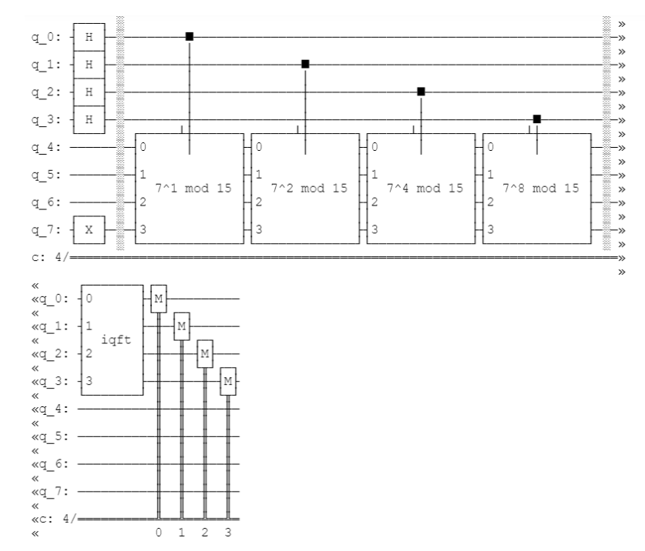

Slide 9

Shor’s Algorithm – Classical Post-Processing Step
If r is odd or if $x^{\frac{r}{2}}$ ≡ -1 mod N, return to step 1 and use a different a
Otherwise, $x^{r}$ ≡ 1 mod N => ($x^{\frac{r}{2}}$ + 1)($x^{\frac{r}{2}}$ - 1) ≡ 0 mod N
Use GCD to find factors: GCD($x^{\frac{r}{2}}$ - 1, N) and/or GCD($x^{\frac{r}{2}}$ + 1, N)
As long as ($x^{\frac{r}{2}}$ + 1) or ($x^{\frac{r}{2}}$ - 1) are not a multiple of N, then one of them should have a non-trivial factor with N
At this point, at least one of the prime factors of N are found, and the other can be found by dividing N by the found factor

Slide 10
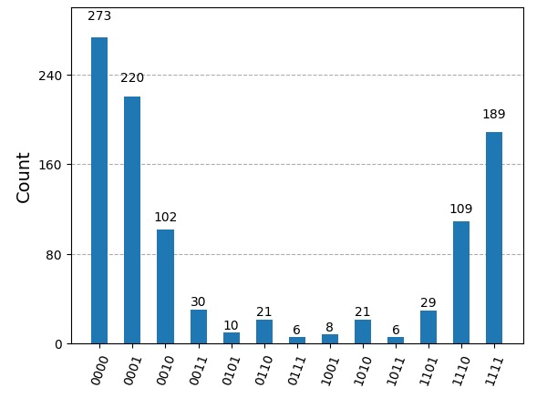
Factoring the Number 15 – Aer Simulator
Our team ran Shor’s algorithm on the number 15 to find the prime factors. Below is the histogram of our measured results from a run using the Aer simulator.

Slide 11

Interpreting the Results
Reading the states in reverse, the only states that concern us are those that end with 0 (even numbers, so that we may find $\frac{r}{2}$).
Highest probabilities are states |0000> and |1000>, representing the numbers 0 and 8
Plugging those numbers in for r in the post-processing algorithm, we find that GCD($x^{\frac{r}{2}}$ - 1, N) = 5 in the case of r = 8 (and 0 when r = 0)
5 is in fact a prime factor of 15! Dividing 15 by 5, we find the other factor: 3.

Slide 12
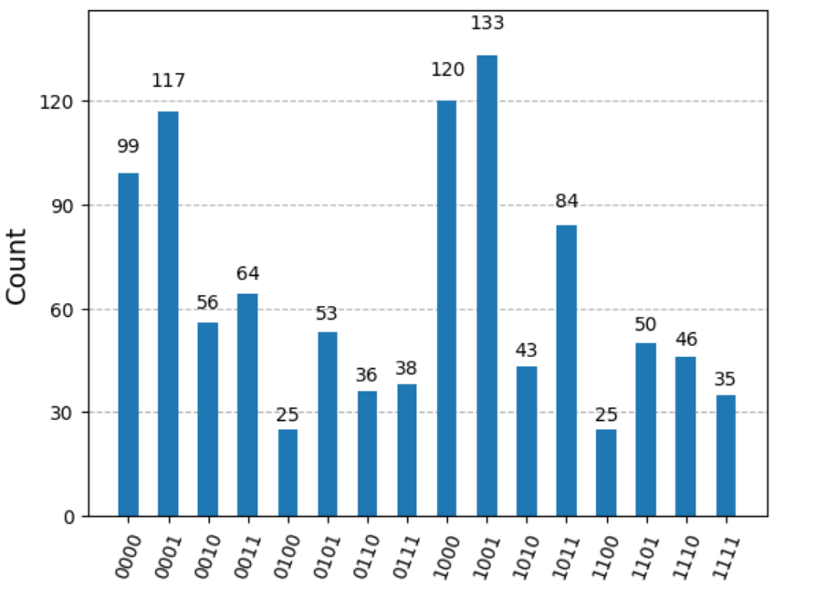
Factoring 15 Using IBM Q-Computer
Running the same circuit through an IBM quantum computer, the results are essentially the same.
The counts are scattered, but looking at the even number states, the top states are |1000> and |0000> respectively, giving factors of 5 & 3 by the same post-processing.

Slide 13
Impact of Shor’s Algorithm
Given the polynomial complexity of Shor’s algorithm, this algorithm will render RSA encryption completely obsolete.
This cannot happen yet due to the limitations of current quantum computers (# of qubits & error correction). However, it’s a matter of time.

Slide 14
The Future of Cryptography
For years, computer scientists have been developing quantum-resistant encryption algorithms, which can’t be easily reversed by quantum or classical computers.
One algorithm uses a lattice of points created by different linear combinations of basis vectors in many dimensions (around 1000). Finding the specific combination to get closest to a given point will break the encryption.
Veritasium provides a demonstration in “How Quantum Computers Break the Internet…Starting Now” (Link to video)

Slide 15
Questions?

